Slide 1

Prepared by MNF1_DAT2_M1d group
Microsoft Power BI Project
Customer Personality Analysis
19 October 2024

Slide 2





Team Members
Marwan Mokhtar
Mohamed Sakr
Moataz Fares
Sadek Ali
Sayed Said
Supervisior
Member
Member
Member
Leader

Slide 3
Content:
Introduction
Preprocessing in the Project
Business question
Dashboard (Power BI)
Analytical SQL
Conclusion & Recommendations

Slide 4
Introduction
A Detailed Analysis of a Company’s Ideal Customers, Seeks to Analyze Customer Data and Identify Distinct Personality Traits That Influence Purchasing Behavior. This Analysis Aims to Enhance Marketing Strategies, Improve Customer Engagement, and Drive Sales by Aligning Products and Messaging with Customer Personalities.

Slide 5
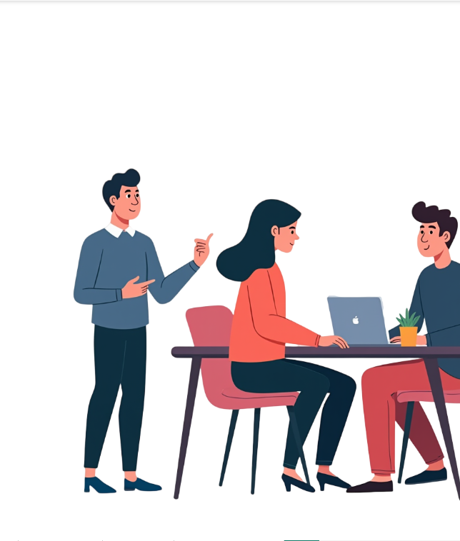
Data Exploratory
• I understood what each column represents.
• I found outliers in the year birth column.
• The "Marital Status" column contains different values referring to the same thing, such as "alone" and "single," "together" and "married."
• In the "Income" column, there is a value of 666666, which could be a test value rather than a real one, There are also null values in this column.
• The "Customer Registration Date" column has inconsistent date formats.

Slide 6
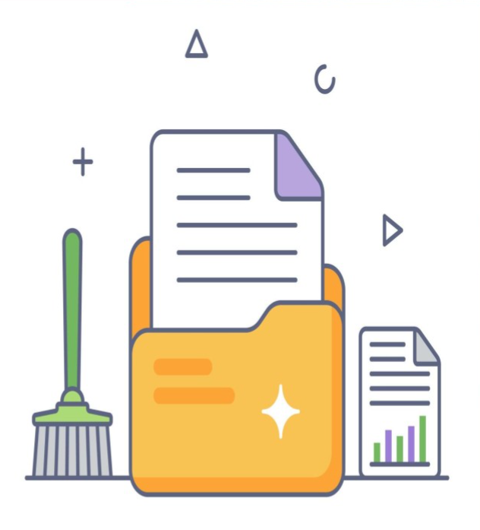
Data Cleaning
•When I opened the data in Excel, it appeared all in one row. The solution: I used split columns to separate the columns.
•I cleaned the data using Power Query.
•I removed the outliers.
•In the "Marital Status" column, I changed "alone" to "single" and "together" to "married."
•I deleted the row with the value 666666.
•I fixed the date formatting by changing all delimiters to "/", then split the date into three columns, and later recombined them.
•I filled the null values in the "Income" column with the average value.

Slide 7
Business question
1.Where is our most revenue coming from?
2.Who are our best customers?
3.What personality types are most likely to engage with our marketing campaigns?
4.Are there any correlations between personality traits and customer satisfaction ratings?
5.How does income level affect purchasing behavior?
6.How do online vs. offline purchase preferences vary among customer segments?
7.What role does recency of purchase play in segment behavior?
8.What is the relationship between promotional campaigns and customer response?
9. What is the impact of household composition on spending habits?
10. What factors drive high-value purchases (luxury items like wine and gold)?
Are high-income customers or specific customer groups (based on education, age, etc.) more likely
to spend on luxury items? What is the correlation between demographics and luxury product spending?

Slide 8
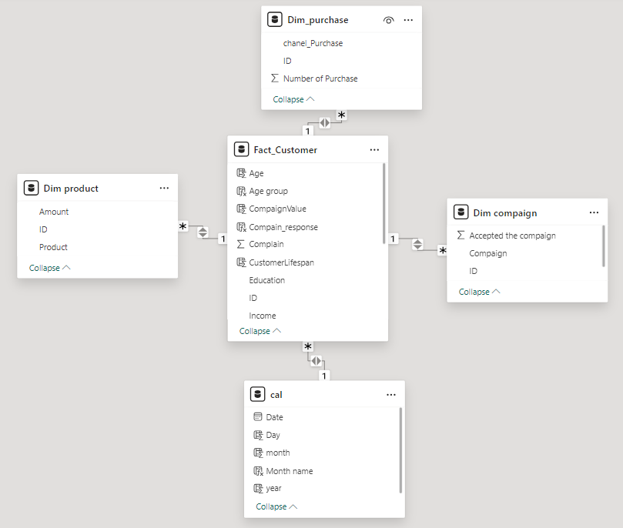
Modeling Data
We divided the data into:
• Fact table:
Fact Customer
• Dimension tables:
Dim campaign
Dim product
Dim purchase
calendar

Slide 9
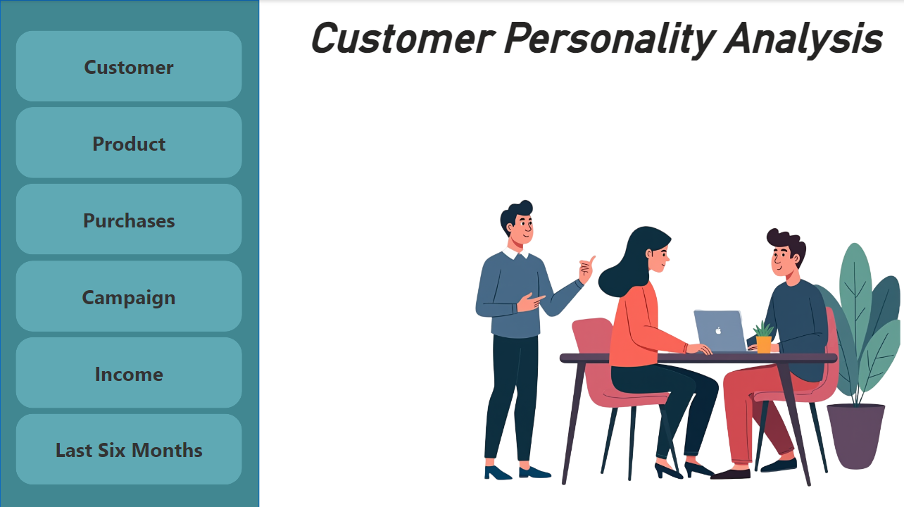
Dashboard (Power BI)

Slide 10
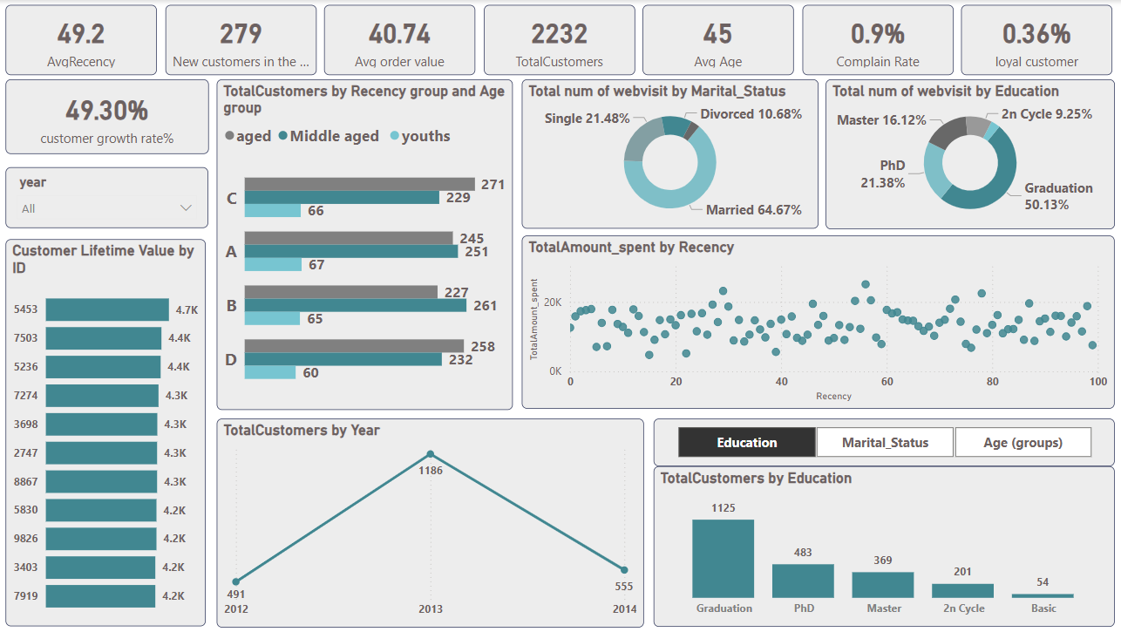
Customer Page

Slide 11
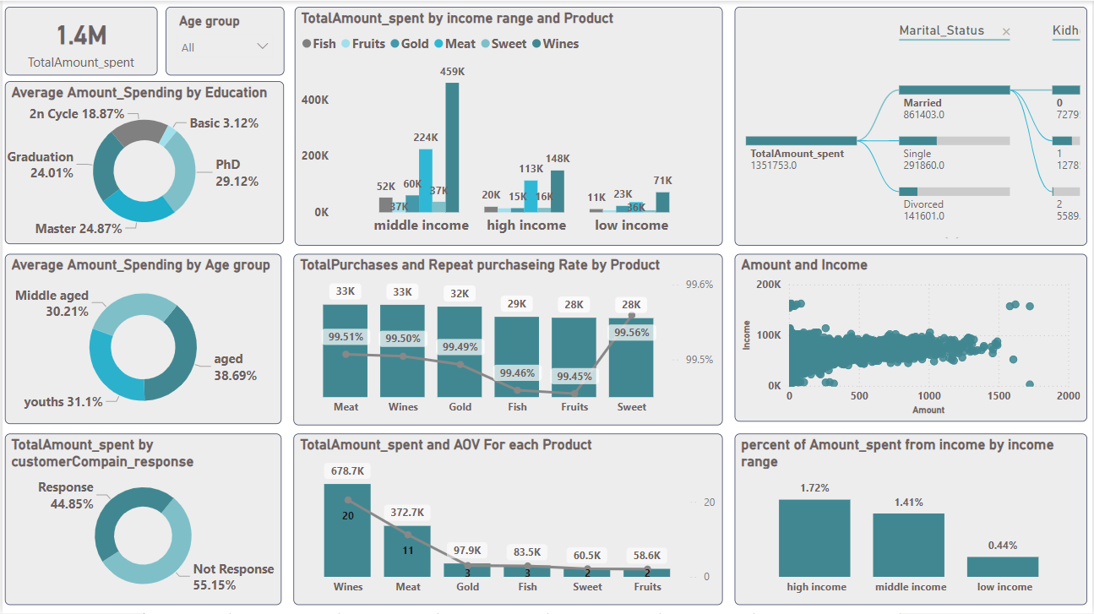
Product Page

Slide 12
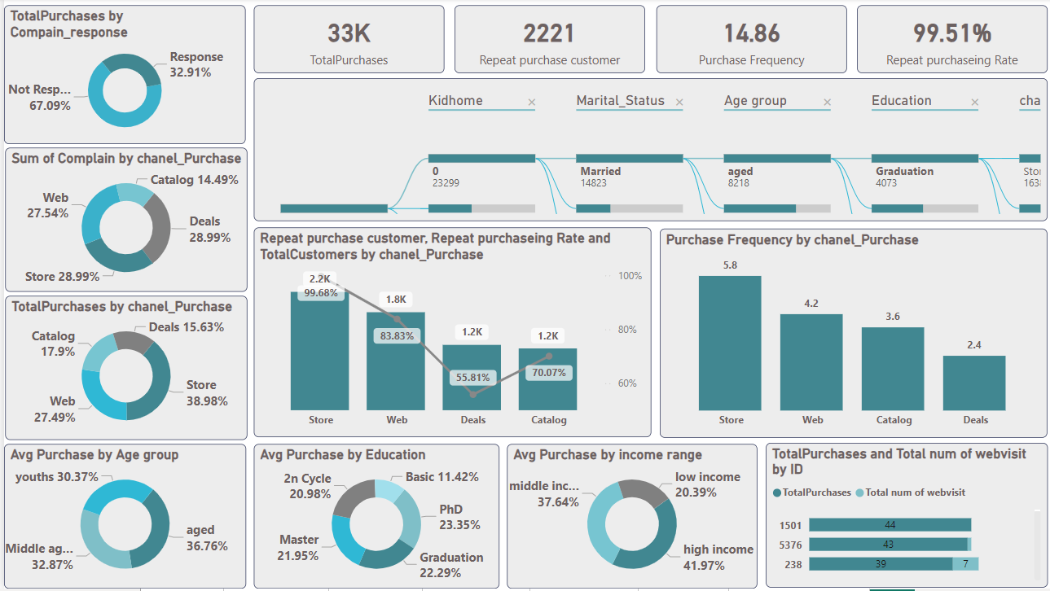
Purchases Page

Slide 13
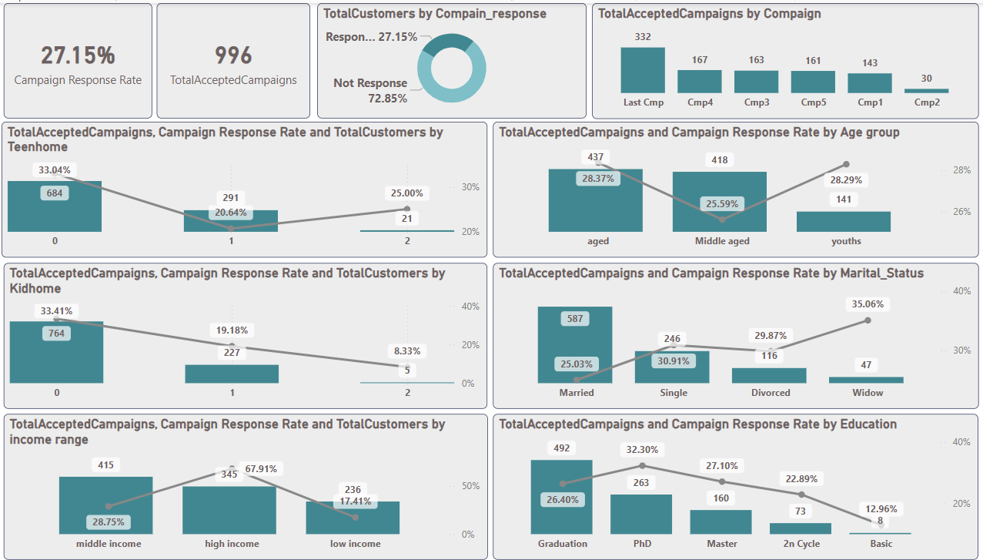
Campaign Page

Slide 14
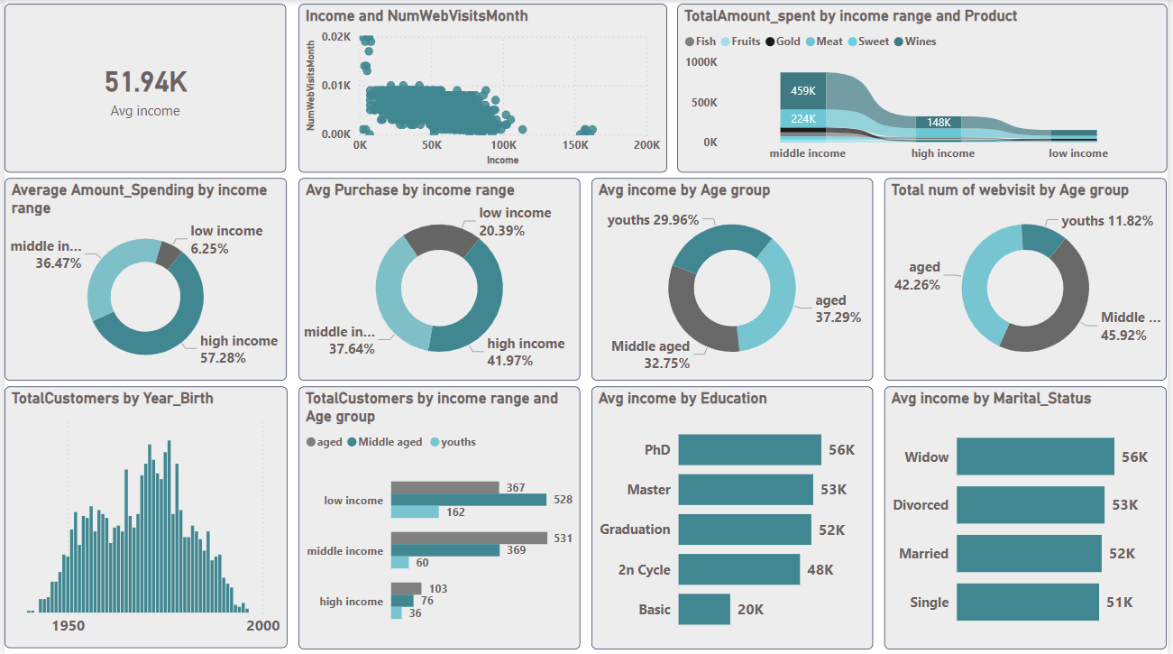
Income Page

Slide 15
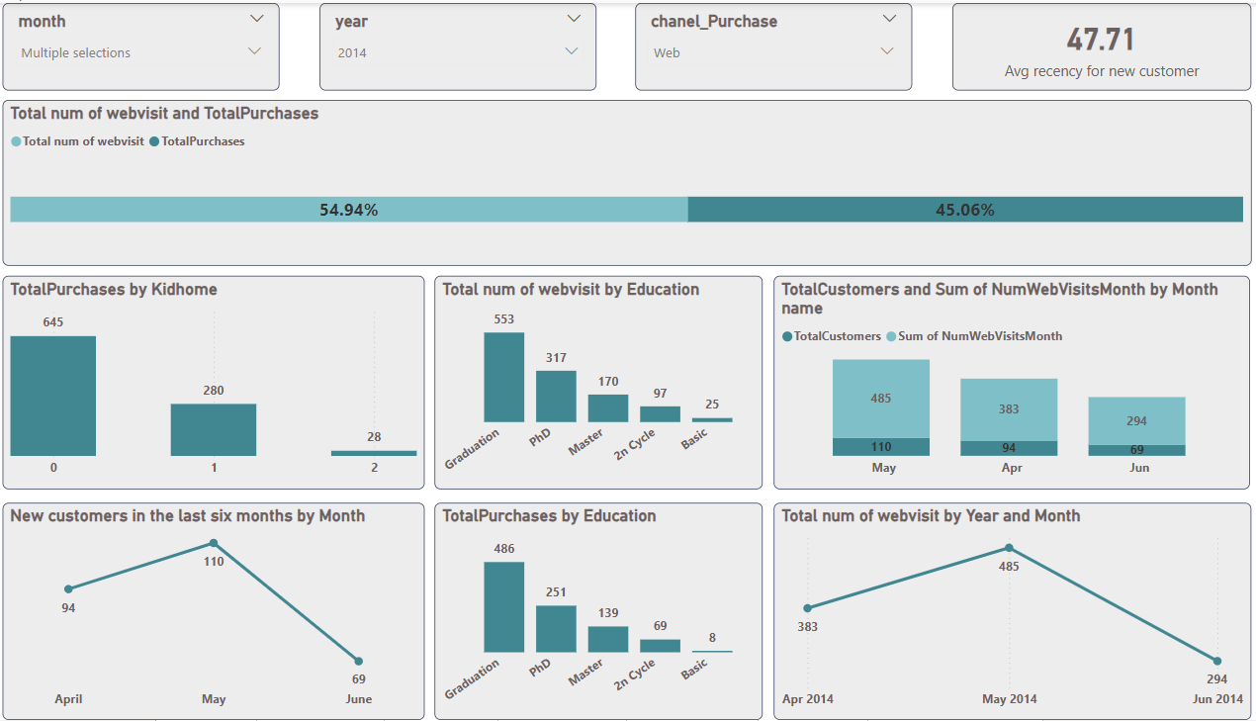
Last Six Months Page

Slide 16
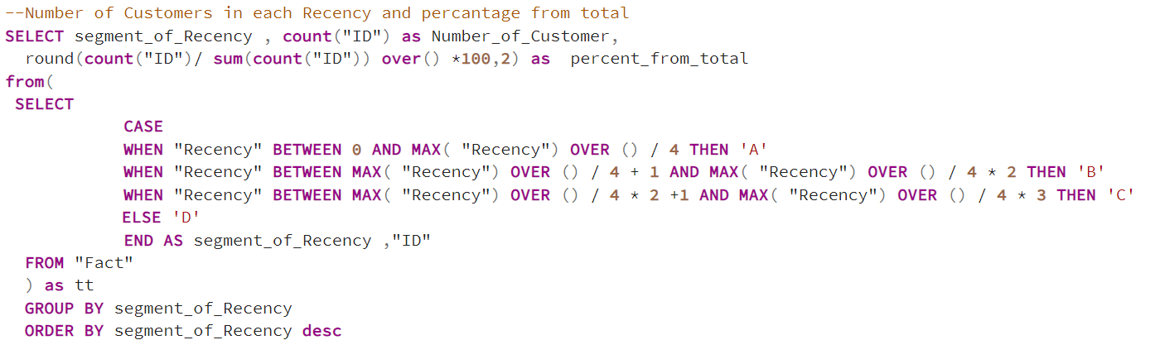
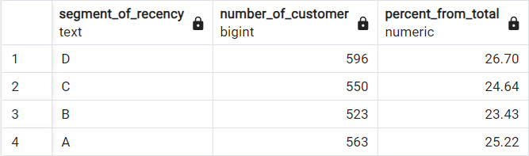
Analytical SQL

Slide 17
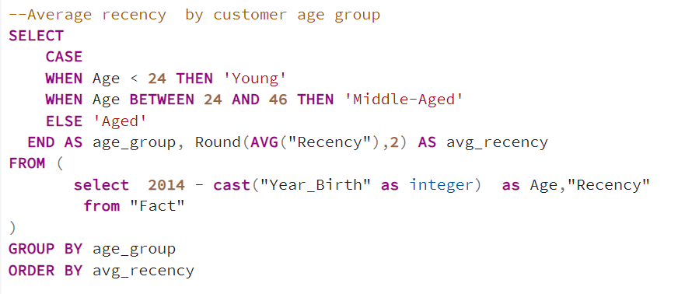
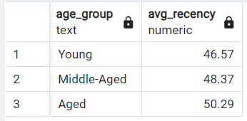

Slide 18
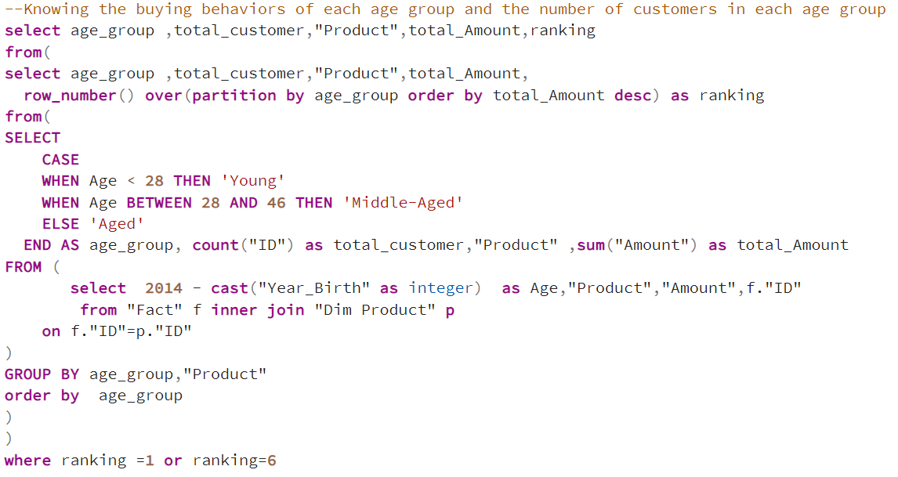
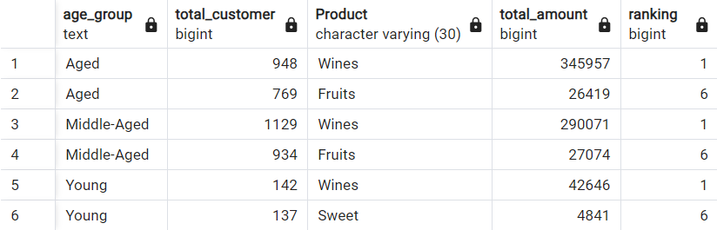

Slide 19
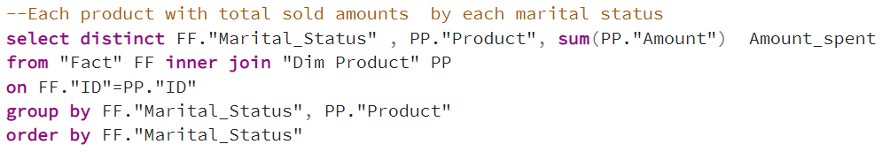
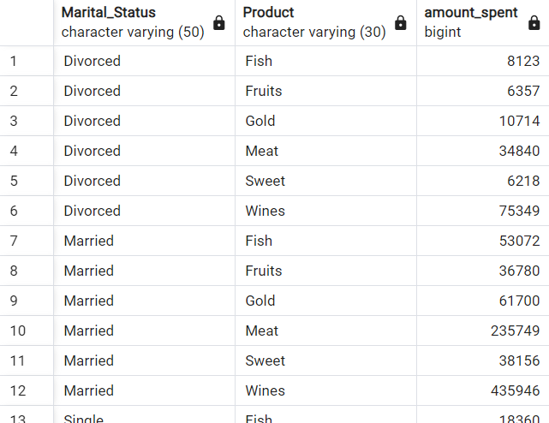

Slide 20
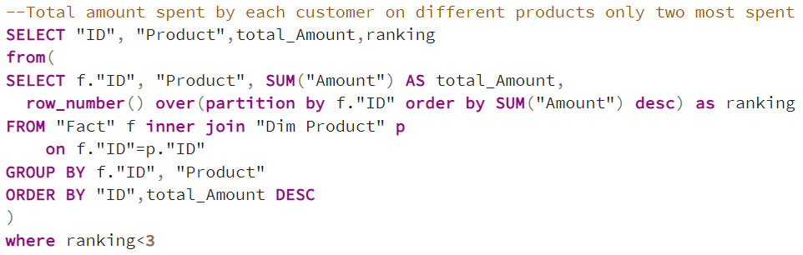
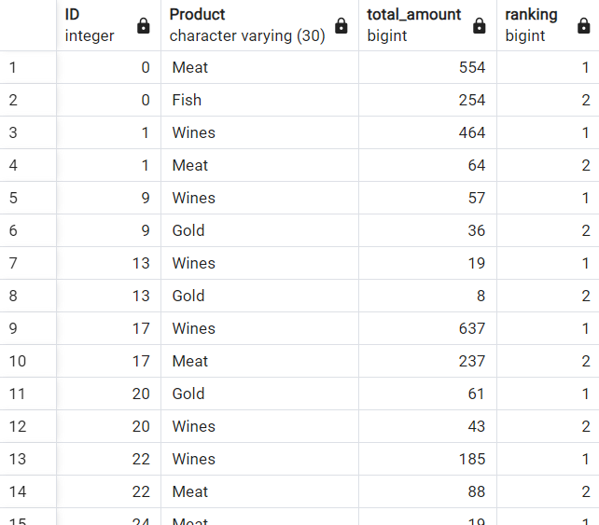

Slide 21
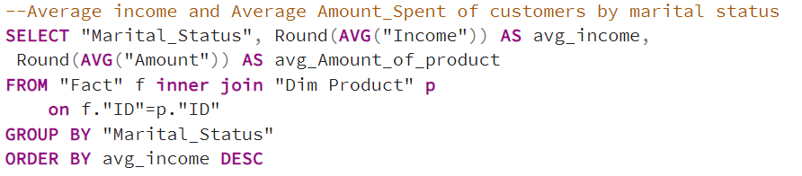
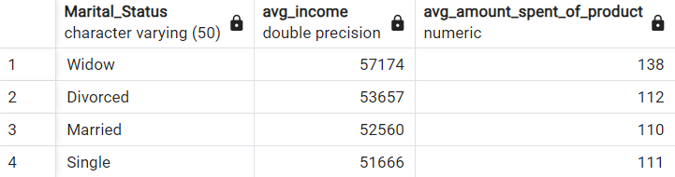

Slide 22
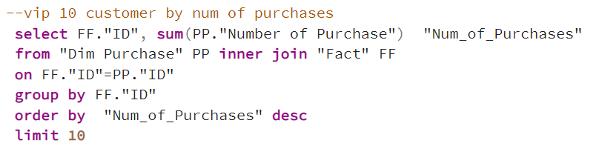
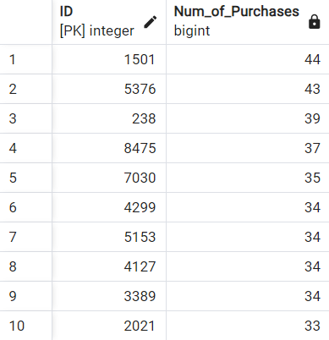

Slide 23
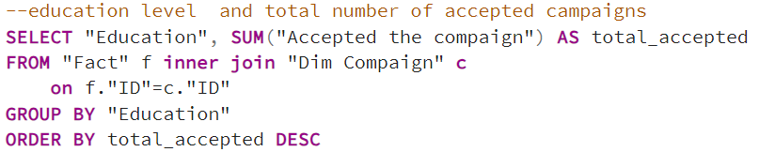
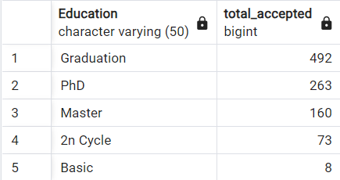

Slide 24
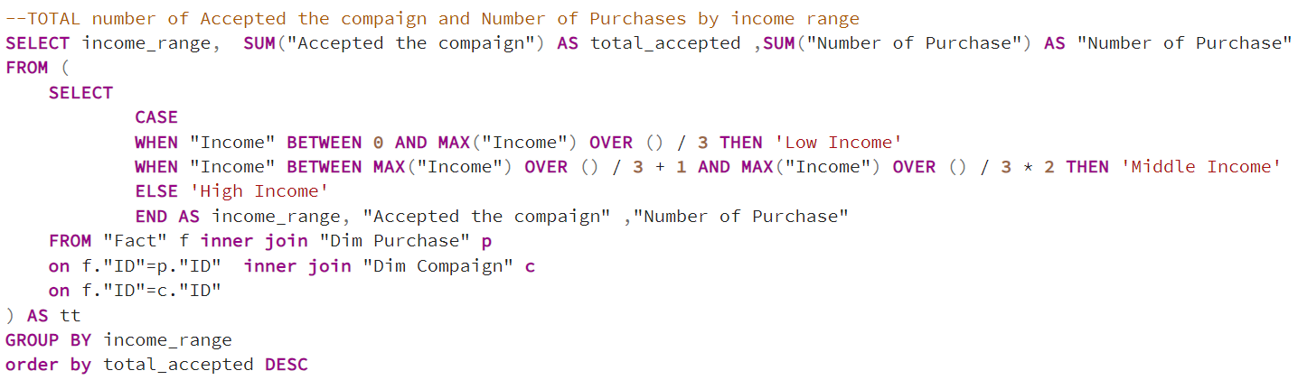
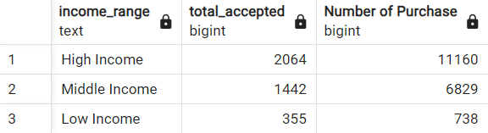

Slide 26
Conclusion
For the last 3 months, I have had no clients.
In the last 6 months, customers have decreased , People who had a large recency had a large Amount spent. High and middle-income customers drive the majority of spending, especially on wine and meat, with strong repeat purchase behavior across all channels. Campaigns targeting these customer segments, particularly highly educated and married individuals, have been most effective. Focusing on retention strategies, improving complaint management, and optimizing store and online promotions will help maximize revenue and customer satisfaction.

Slide 27
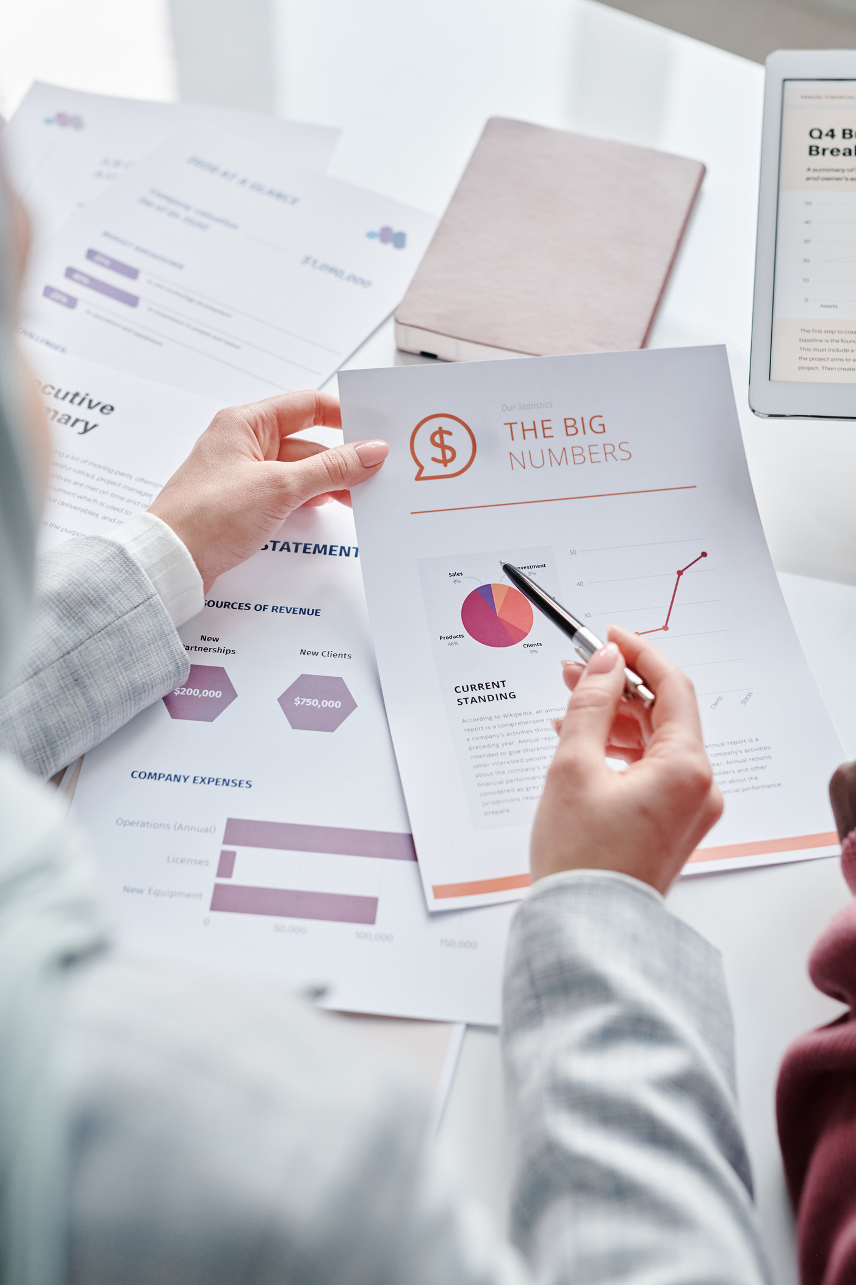
Recommendations
Focus on Married Customers: Since 64.67% of the customers are married, tailor campaigns specifically for this segment to increase engagement and retention.
Increase Engagement for Youths: The youth segment (0-30 days) has the lowest number of customers. Implement campaigns focused on this age group.
Target Graduates: 50.13% of your visitors have graduated, indicating a potential to market services or products geared toward this educational level.
Increase Customer Loyalty: With only 0.36% of loyal customers, introduce a loyalty or rewards program to retain more clients and improve this metric.
Focus on High-Income and Middle-Income Segments: High-income customers spent significantly on gold and wines (459K on gold, 224K on wines). Offer premium or exclusive promotions to these customers, as they generate high revenue. Middle-income customers also spend well, especially on wines and meat.

Slide 28
Recommendations
Address Non-Responsive Customers: Since 55.15% of customers are non-responsive, work on improving communication and engagement. Personalized outreach or follow-ups might encourage more interaction.
Target Older and Youth Customers: Aged customers (38.69%) and youth (31.1%) represent substantial spending. Create age-specific marketing strategies to maximize their spending potential.
Encourage Repeat Purchases: Products like meat, wines, and sweets have high repeat purchase rates (99.5%+). Introduce subscription services or repeat purchase incentives for these products to drive consistent sales.
• Maximize on Educational Segments: Customers with PhDs and Masters spend the most (29.12% and 24.87%, respectively). Consider creating campaigns targeting these educated customers with tailored messaging or value-driven offers.
• Further Analyze the Marital and Kid Home Impact: Consider family-oriented offers or loyalty programs. Test specific promotions for households with kids

Slide 29
Thank you

